Slide 1



Module 5
Style Sheets

Slide 2


Module Overview
In this module, you will learn about:
Style Sheets
Selectors in CSS
Properties and Values
Inheritance and Cascades in CSS

Slide 3

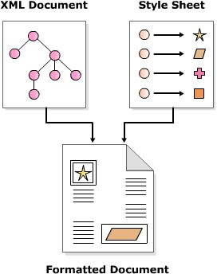
Need of Style Sheets
They are a set of rules that describe the appearance of data
in an XML document.

Slide 4
Various Style Sheets
Cascading Style Sheet (CSS)
It allows you to control the appearance of data in HTML and XML documents.
Extensible Style Sheet (XSL)
It is used to define the appearance of data contained only in XML documents.

Slide 5
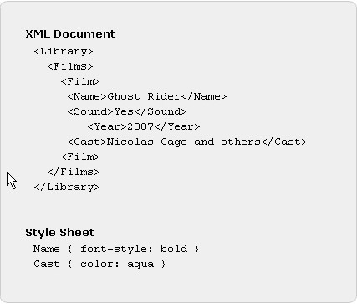
Cascading Style Sheets
It comprises a set of rules for various elements in a document.
Each rule defines how the data enclosed in the element should be displayed.
The term cascading is derived from this ability to mix and match rules.

Slide 6
Benefits of CSS
Any style or presentation changes to data can be achieved faster as changes are to be implemented in one place.
Device independence can be achieved by defining different style sheets for different device.
Reduction in document code as the presentation information is stored in a different file and can be reused.

Slide 7
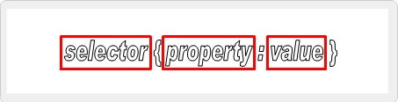
Style Rules
They define how the content enclosed in an
element will be displayed.
These rules are applicable to all child elements within an element.
Selector
Property
Value

Slide 8
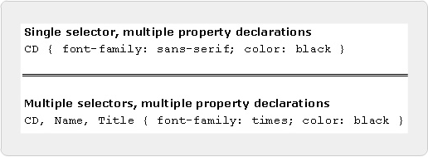
Ways of Writing Style rules
A single selector can have more than one property-value
pairs associated with it.
A collection of one or more property-value pairs can be associated with more than one selector.

Slide 9
External Style Sheets
It should appear in the prolog section of an XML document, that is, it should appear before any tag of an element.
One XML document can have more than one style sheet processing instructions, each linked to one .css file.
Syntax
<?xml-stylesheet href=”headers.css” type=”text/css”?>
where,
xml-stylesheet is the processing instruction.
url is the URL of a .css file; the .css file can on a local system or
anywhere on the Internet.
type=”text/css” is optional; however if a browser does not support
CSS, it informs the browser that it does not have to download a .css file.
Code Snippet
<?xml-stylesheet href=”url” [type=”text/css”]?>

Slide 10
Simple Selectors
It comprises an element name followed by one or
more property declarations.
It match every occurrence of the element in a document.
Code Snippet
/* Simple selector */ CD { color: black }
/* Single element, multiple property declarations */ CD { color: white; background-color: blue }
/* Multiple elements, multiple property declarations */ CD, Name, Title { color: white; background-color: blue }

Slide 11
Universal Selector
It comprises an asterisk followed by property
declarations.
It matches all the elements in a document.
Code Snippet
* { color : blue }
Displays the content of all elements in a document in blue.

Slide 12
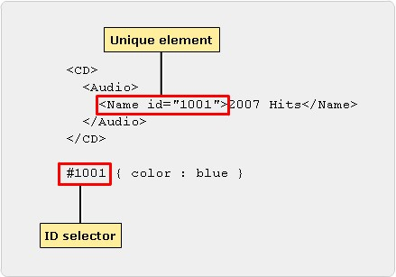
ID Selector 1-2
It comprises a hash (#) symbol, immediately followed by an attribute’s value followed by property declarations.
It is used to define styles for unique elements in a document.

Slide 13

ID Selector 2-2
Syntax
#attribute_value { property_declarations }
Code Snippet
#1001 { color : blue }
Displays the content of an element in blue if its id attribute’s value equals 1001.

Slide 14
Color Properties
Color Names | RGB Percentages | RGB Values | Hexadecimal Values
aqua | rgb(0%,65%,65) | rgb(0,160,160) | #00a0a0
black | rgb(0%,0%,0%) | rgb(0,0,0) | #000000
blue | rgb(0%,32%,100) | rgb(0,80,255) | #0050ff
gray | rgb(65%,65%,65%) | rgb(160,160,160) | #a0a0a0
green | rgb(0%,100%,0%) | rgb(0,255,0) | #00ff00
lime | rgb(0%,65%,0%) | rgb(0,160,0) | #00a000
maroon | rgb(70%,0%,32%) | rgb(176,0,80) | #b00050
navy | rgb(0%,0%,65%) | rgb(0,0,160) | #0000a0
olive | rgb(65%,65%,0%) | rgb(160,160,0) | #a0a000
purple | rgb(65%,0%,65%) | rgb(160,0,160) | #a000a0
red | rgb(100%,0%,32%) | rgb(255,0,80) | #ff0050
silver | rgb(90%,90%,90%) | rgb(225,225,255) | #d0d0d0
teal | rgb(0%,65%,100%) | rgb(0,160,255) | #00a0ff
white | rgb(100%,100%,100%) | rgb(255,255,255) | #ffffff
yellow | rgb(100%,100%,0%) | rgb(255,255,0) | #ffff00

Slide 15

Setting Color Properties 1-3
Syntax
where,
color
Property to set the foreground color of text in an element.
colorValue
colorValue can take up any value from the CSS color table.
background-color
Property to set the background color of text in an element.

Slide 16

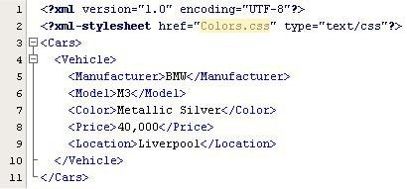
Setting Color Properties 2-3
Code Snippet

Slide 17
Setting Color Properties 3-3
Style Sheet
where,
Cars { background-color:rgb(0%,32%,100%);color:
#ffffff }
Causes the text enclosed in Cars element to be displayed in white color with a background color of blue.
Price{color:yellow;}
Causes the text enclosed in Price element to be displayed in yellow color.
Output

Slide 18
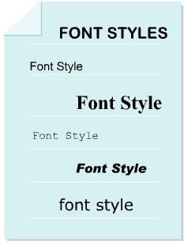
Font Properties
Property Name | Description
font-family | To specify the font family
font-size | To specify the size of font
font-style | To specify the style of font
font-weight | To specify the weight of font

Slide 19
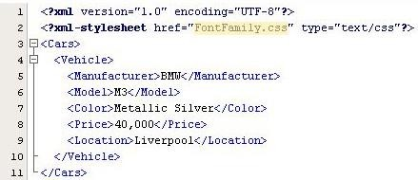
Font-family Property 1-2
Syntax
where,
font-family
Property to specify the font-family to be used.
font-family name(s)
Comma separated list of font-family names such as serif, san-serif, monospace, cursive, and fantasy. The list should start with the most specific font in which you want to display the data and end with the most generic font.
Code Snippet

Slide 20
Font-family Property 2-2
Style Sheet
Output

Slide 21
Font-size Property 1-3
Syntax
where,
font-size
Property to specify the size of font.
xx-small|x-small|small|medium large|x-large|xx-large
One of various values that can be assigned to the property font-size.

Slide 22
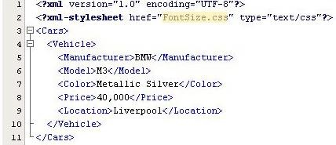
Font-size Property 2-3
Code Snippet

Slide 23


Font-size Property 3-3
Style Sheet
where,
Cars{font-size:medium }
All the text enclosed in Cars element and its child elements will be displayed with medium font size.
Output

Slide 24


Font Style and Weight Properties 1-3
Syntax
where,
font-style
Property to specify the style of text in an element.
normal|oblique|italic
One of the values that can be assigned to font- style property.
font-weight
Property to specify the weight style of the text in an element.
light | normal | bold
One of the values that can be assigned to font- weight property.

Slide 25
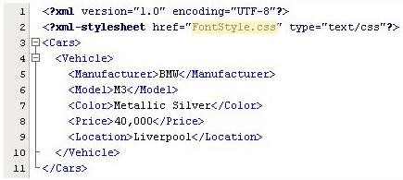
Font Style and Weight Properties 2-3
Code Snippet

Slide 26

Font Style and Weight Properties 3-3
Style Sheet
where,
Manufacturer { font-weight: bold }
The text enclosed in Manufacturer element will be displayed in bold.
Location {font-style: italic}
The text enclosed in Location element will be displayed in italics.
Output

Slide 27
Margins in CSS 1-3
Syntax
where,
margin-left | margin-right | margin-top | margin- bottom
The various margin properties to set left, right, top and bottom margins.
marginValue
The value to be assigned to one of the margin properties.This value can be a fixed value or a percentage.

Slide 28
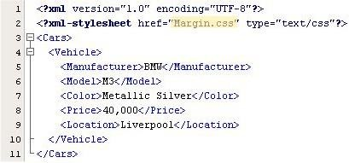
Margins in CSS 2-3
Code Snippet

Slide 29

Margins in CSS 3-3
Style Sheet
where,
Manufacturer {margin-left:20;margin-right:50;}
Inserts a space of 20 pixels to the left and a space of 50 pixels to the right of text enclosed in element Manufacturer.
Manufacturer {background-color: aqua}
Sets the background of text enclosed in element Manufacturer to aqua.
Vehicle {background-color: orange}
Sets the background of text enclosed in element Vehicle to orange.
Output

Slide 30
Border Properties in CSS 1-3
Syntax
Output
where,
border: Property to set the border of the box surrounding an
element’s data.
border_width: Specifies the thickness of the border.
Possible values are thin, medium and thick. border_style: Specifies the style of the border. Possible values are solid, dashed, dotted, groove, ridge, double, inset, outset.
border_color: Specifies the color of the border. All values
that are applicable to CSS color property are allowed.

Slide 31

Border Properties in CSS 2-3
Code Snippet

Slide 32



Border Properties in CSS 3-3
Style Sheet
where,
Manufacturer {border: thick dashed magenta }
Displays a thick and dashed magenta border around the content of Manufacturer element.
Model { border: thick solid olive }
Displays a thick and solid olive border around the content of Model element.
Color {border: thick groove aqua}
Displays a thick and groove aqua border around the content of Color element.
Price {border: thick inset gray}
Displays a thick and inset gray border around the content of Price element.
Output

Slide 33

Padding Properties in CSS 1-2
Syntax
Code Snippet

Slide 34
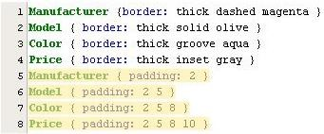

Padding Properties in CSS 2-2
Style Sheet
where,
Manufacturer { padding: 2 }
Inserts padding of 2 pixels between the four borders and text of Manufacturer element. The four borders applicable are top, right, bottom, and left.
Model { padding: 2 5 }
Inserts padding between the borders and text of Model element. The value 2 is applied to top and bottom borders and 5 is applied to left and right borders.
Color { padding: 2 5 8 }
Inserts padding between the borders and text of Color element. The value 2 is applied to top border, 5
to left and right borders, and value 8 to bottom border.
Price { padding: 2 5 8 10 }
Inserts padding between the borders and text of Price element. The value 2 is applied to top border, 5 to right border, 8 to bottom border, and 10 to left border.
Output

Slide 35
CSS Units
Unit Type | Unit Designator
Relative | em – defines the height of element’s font. ex – defines the x-height of element’s font. px – defines the pixel relative to display device. % - percentage.
Absolute | in – inches cm – centimeters mm – millimeters pt – 1/72 inch pc – 12 pt

Slide 36
Position Properties
Property | Description | Possible Values
position | Property to place an element in a static, relative, absolute or fixed position | static, fixed, relative or absolute
top | Property specifying how far the top edge of an element is above/below the top edge of the parent element | auto, integer or floating point values adhering to CSS length units
left | Property specifying how far the left edge of an element is to the right/left of the left edge of the parent element | auto, integer or floating point values adhering to CSS length units
bottom | Property specifying how far the bottom edge of an element is above/below the bottom edge of the parent element | auto, integer or floating point values adhering to CSS length units
right | Property specifying how far the right edge of an element is to the left/right of the right edge of the parent element | auto, integer or floating point values adhering to CSS length units

Slide 37
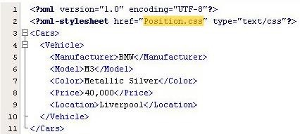
Position Properties Example 1-3
Code Snippet

Slide 38

Position Properties Example 2-3
Style Sheet
where,
Location {position:relative;top:20;left:20}
Positions the text of Location element relative to the previous element. However, inside the box, the content is placed at 20 pixels from top and 20 pixels from left.
Price {position:absolute;top:40;left:20}
Positions the text of Price element at an absolute location of 40 pixels from the top and 20 pixels from the left.

Slide 39


Position Properties Example 3-3
Output
where,
40,000
Text displayed using absolute positioning
Liverpool
Text displayed using relative positioning

Slide 40

Display Property 1-3
Syntax
where,
display
Property to specify how the element is to be rendered.
none
No rendering is applied to the element.
inline
Displays the element text as in line.This is the default value if no value is
specified.
Block
Displays the element text on a new line in a block of its own.

Slide 41

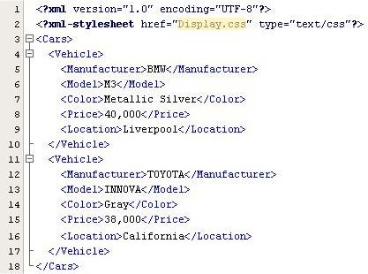
Display Property 2-3
Code Snippet

Slide 42
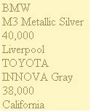
Display Property 3-3
Style Sheet
where,
Price { display: block }
Inserts a new line before and after the text of element Price.
Output

Slide 43

Text Alignment and Indentation 1-3
Syntax
where,
text-align
Property to align the text in a block.
alignment_value
Can be one of the following: left(default), right, center and justify.
text-indent
Property to indent the text in a block.
value
Floating point value followed by absolute units designators or relative units designators; or an integer value followed by percentage (%) symbol.

Slide 44
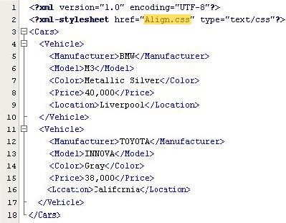
Text Alignment and Indentation 2-3
Code Snippet

Slide 45


Text Alignment and Indentation 3-3
Style Sheet
where,
Price {display: block}
Inserts a new line before and after the text of element Price and displays the text in a separate block.
Price {text-align: left}
Left aligns the text of Price element.
Price {text-indent: 20}
Indents the text of Price element at 20 pixels.
Output
where,
40,000
The text in element Price is display on a separate row and left indented at 20 pixels.

Slide 46
Cascading in CSS
All declarations that apply to an element and
property are grouped.
Declarations are sorted by weight and origin.
Declarations are sorted by specificity of selector.
Declarations are sorted by the order specified.

Slide 47
Inheritance in CSS 1-2
Inheritance is the ability of one entity to acquire the
characteristics of another entity.
In CSS, the child elements inherit the styles rules defined for parent element.
However, this is applicable only if the child has no explicit style rule defined for it.
Otherwise, the style rule defined for child element
overrides the style rule defined for parent element.

Slide 48
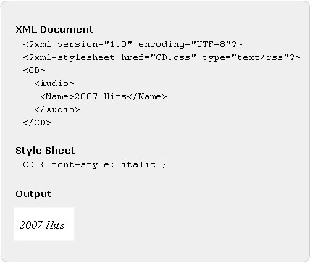
Inheritance in CSS 2-2

Slide 49
Summary
Style Sheets
Style Sheets are a set of rules that define the appearance of data.
These rules are written in a file with the extension .css.
The .css file is associated with an XML document using the xml- processing instruction.
Selectors in CSS
Selectors define the elements to which the styles will be applied.
The various types of selectors are simple, universal and ID selectors.
Properties and Values
CSS provides several properties to define the appearance of data.
Some of these properties are color, background-color, position, padding,
font, text- align to name a few.
Inheritance and Cascades in CSS
In CSS, a child element inherits the styles rules applied to its ancestor element.
Also there are several sources of style sheets, hence CSS follows W3C
defined cascading order when applying style rules to elements.

